Slide 1

Laird Sentrius MG100 Gateway

Slide 2
Introduction
The Sentrius MG100 Gateway is an out-of-the-box product allowing the end user to develop a fully featured IoT solution with minimum effort.
The addition of the optional battery backup, it provides uninterrupted reporting of sensor data.
Based on Laird Connectivity's Pinnacle™ 100 modem, the Sentrius MG100 Gateway captures data from Bluetooth 5 sensors and sends it to the cloud via a global low power cellular (LTE-M/NBIoT) connection.

Slide 3
Key Hardware Features
PinnacleTM 100 modem integrated – Integrated antenna option provides low cost, low profile product packaging – External antenna option provides long range connectivity for cellular and Bluetooth networks.
Optional battery backup with battery charger enables additional operating time without external power (specific duration is use case dependent) – Battery charger auto detects charging capability of external power source – Load sharing charger allows for normal operation while charging.
3 LEDs providing a user programmable visual interface of gateway operating status.
NFC interface, including antenna.
microSD card connector for flexible memory expansion. Integrated accelerometer for detecting movement of MG100 unit.
Integrated temperature sensor measures gateway electronics operating temperature.
External accessible tactile button for user configurable functionality.
Integrated USB to UART converter creates virtual comm port when external USB port is connected to the gateway.
Protected on/off switch for Power On Reset and transporting battery backup versions.

Slide 4
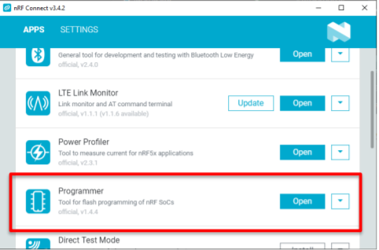
Software Setup
Download and install the nRF Connect software tool from the Nordic website: https://www.nordicsemi.com/Software-andtools/Development-Tools/nRF-Connect-for-desktop/Download.
Once the nRF Connect software has installed, a secondary prompt screen will appear with App options.
Install and Update the Programmer app.
Open the Programmer app once installed and updated.

Slide 5
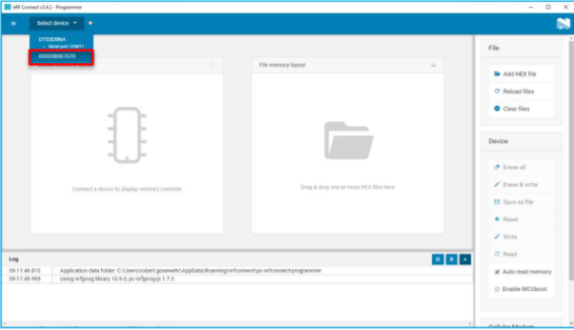
Programming MG100
Once the Programmer App has started, in the upper left corner, press on the Select device drop down list and select the device with the leading zeros:
After the device selection the software will read the memory layout from the Nordic nRF52840 chipset from the PinnacleTM 100 modem installed in the micro-gateway and display it on the left side.

Slide 6
MG100 Firm Download
The Out of Box Demo (OOB) firmware, Laird part number 480-00070, and the bootloader, Laird part number 480-00053, for the micro-gateway can be found on Laird’s GitHub site: MG100 Firmware.
Download the OOB and bootloader firmwares and place in an easy to find file location. The firmware will save to the default location (Downloads folder on Windows) when downloaded from the GitHub site.

Slide 7
Loading Firmware
Load the two firmwares (OOB & Bootloader) into the Programmer App software by clicking on the Add Hex File button on the right column menu under the File header.
Browse for the file location of the two firmware files and select the necessary firmware.
Only one firmware file can be selected at a time so will need to repeat this step to load the other firmware.
The order of selecting the files does not matter.

Slide 8
Programming gateway
Once the two firmwares have been added, the file memory layout on the screen will update.
From here, click on Erase & Write action under the Device header to start the firmware update.
Once the update has completed, the memory allocation for the Nordic chipset will also update.
The firmware update is completed at this point, and the gateway is ready to run the Out of Box Demo.
Reference the Out of Box Demo documentation found on the Laird GitHub site to see how the demo operates.

